Slide 1
New England marine mammal and sea turtle Stranding Data Analysis
Josh Meza-Fidalgo, Jess Ozog, Britney Pepper

Slide 2
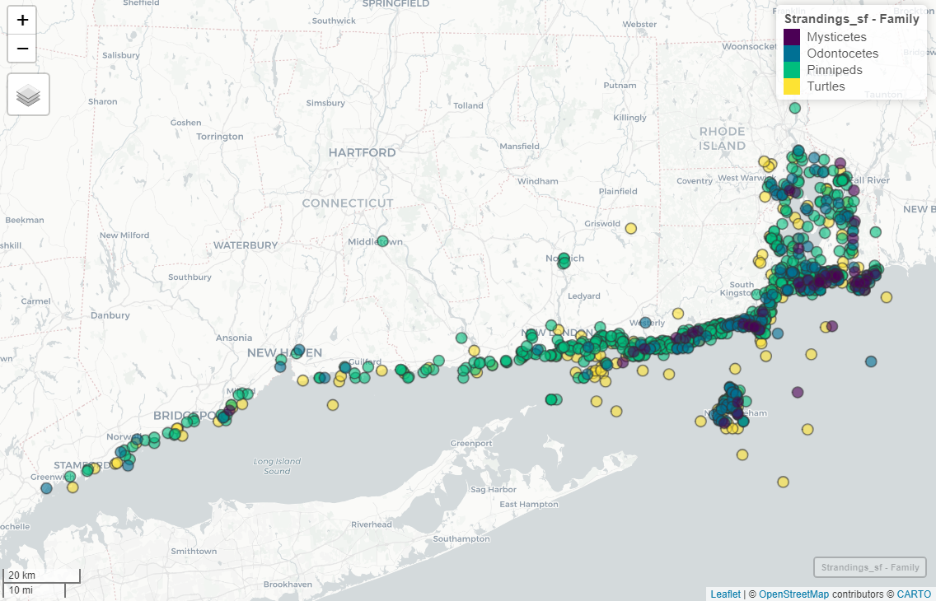
Data
Stranding data collected by Mystic Aquarium from 1990– 2011
Spatial range: Connecticut and Rhode Island
Curated & managed by OBIS-SEAMAP
1,140 cetacean, pinniped, and sea turtle strandings
679 Pinnipeds
256 Turtles
155 Odontocetes
50 Mysticetes

Slide 3
Questions
Are there any significant differences between years and/or months for strandings for each family group?
How are the strandings related geospatially? Are there potential stranding hotspots?
Are there any temporal trends/patterns?

Slide 4
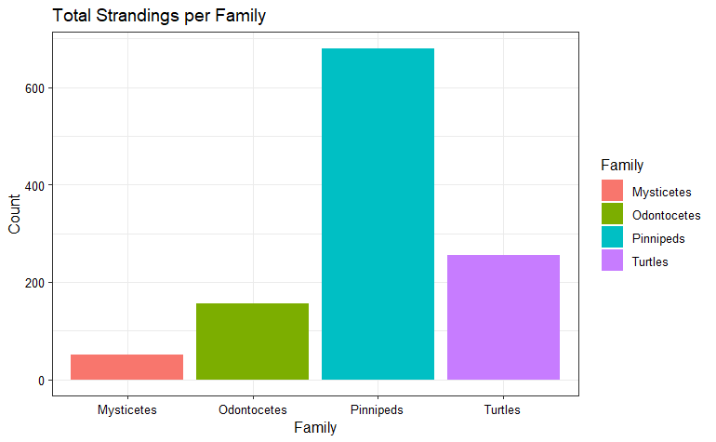
Wrangling and exploration
Divided into 4 families for specific analyses
Pinnipeds
Turtles
Mysticetes (baleen whales)
Odontocetes (toothed whales)
Further wrangling to determine # of strandings of each family by year and month
Geospatial Wrangling

Slide 5
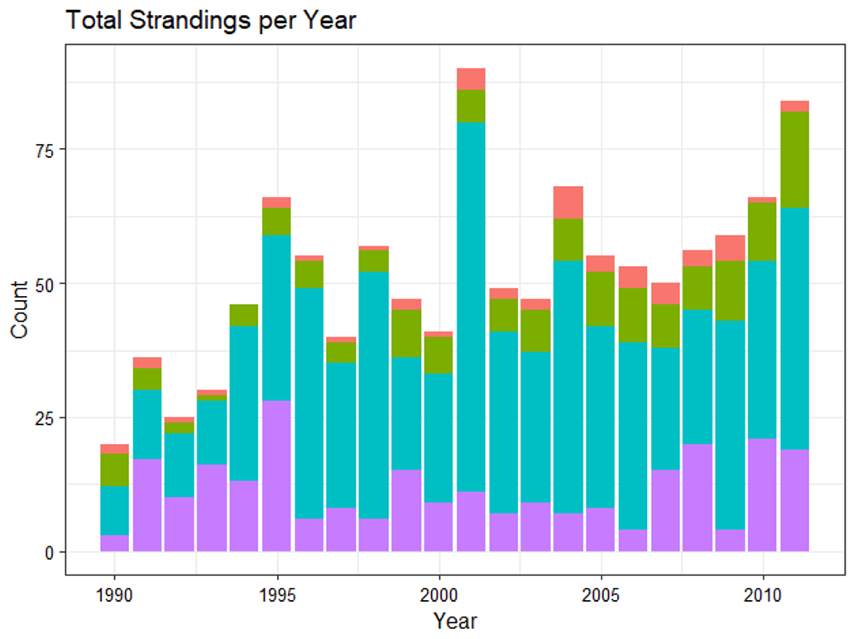
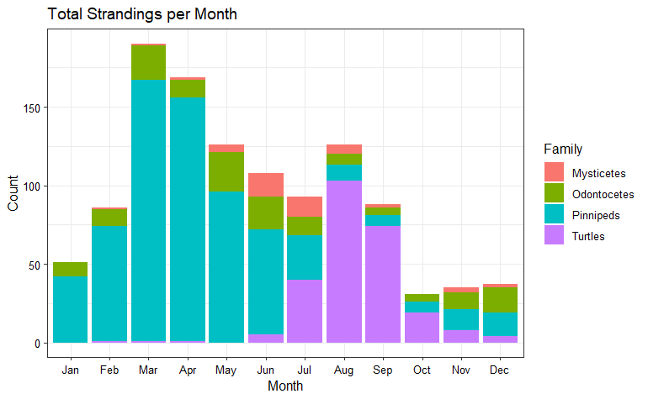
Strandings summary

Slide 6
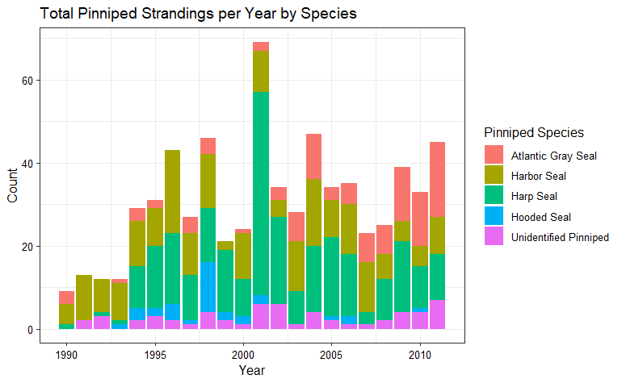
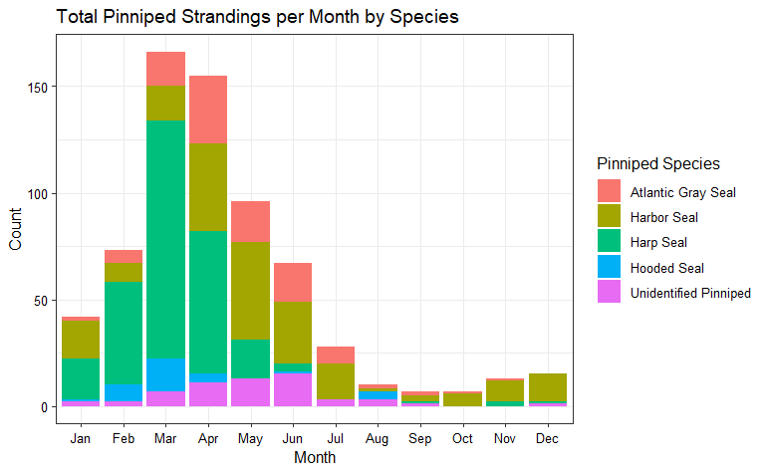
Pinnipeds
2001: most statistically significant (p-value < 0.05)
Jan, Mar – Apr most statistically significant (p-values <0.05)

Slide 7
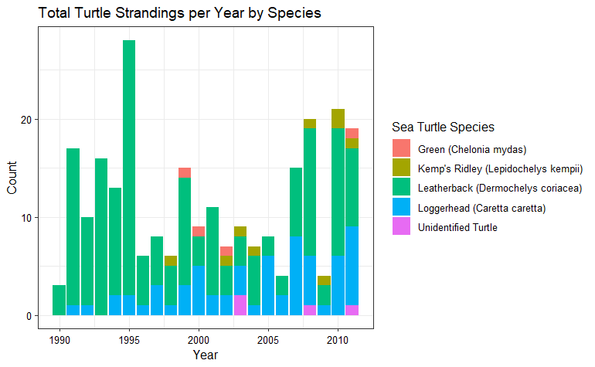
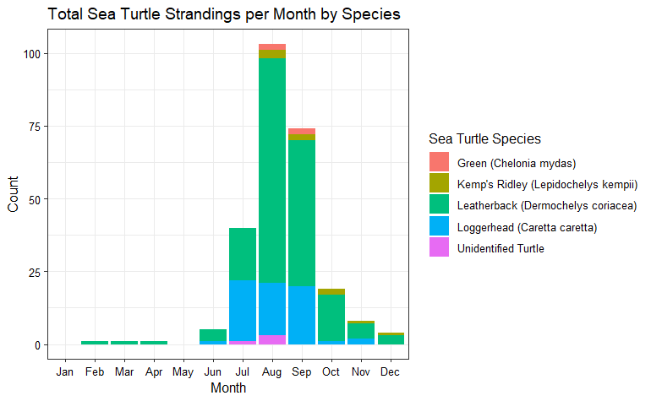
Sea turtles
1995: most statistically significant (p-value < 0.05)
June – September: most statistically significant (p-values < 0.05)

Slide 8
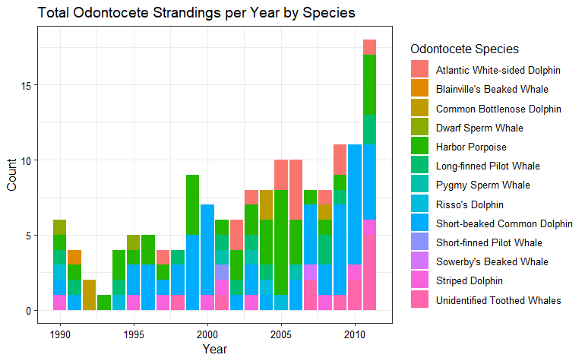
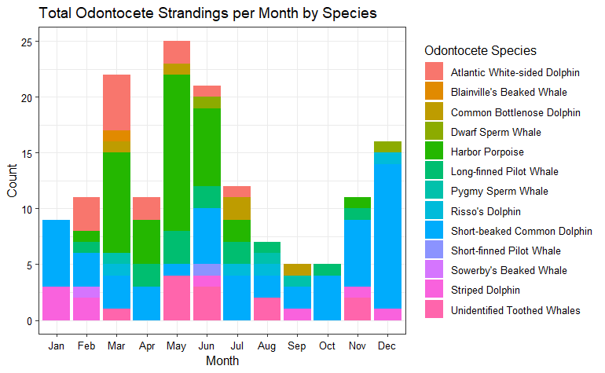
odontocetes
1990, 2011 most statistically significant (p-values <0.05)
Jan, Mar, May – June most statistically significant (p-values <0.05)

Slide 9
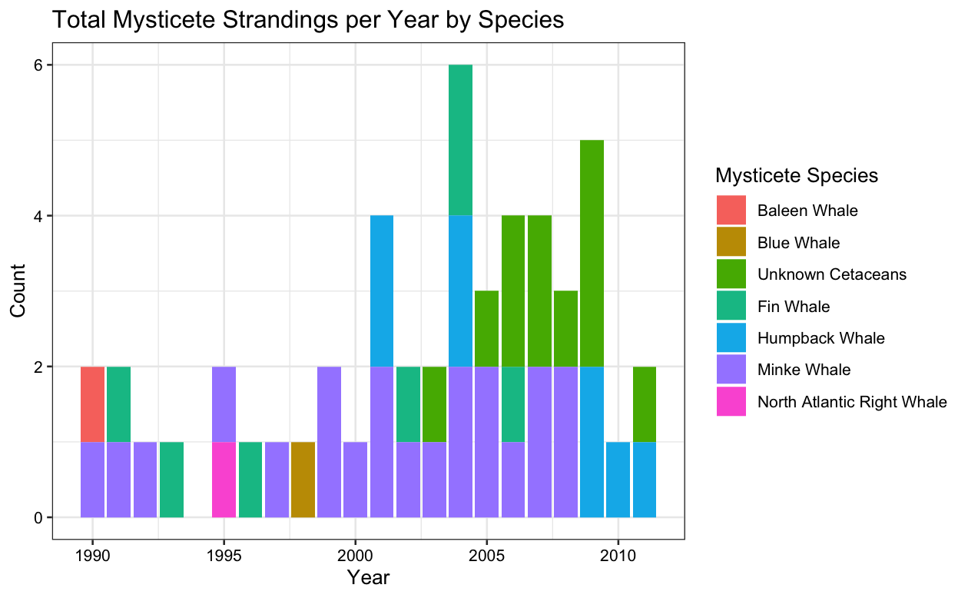
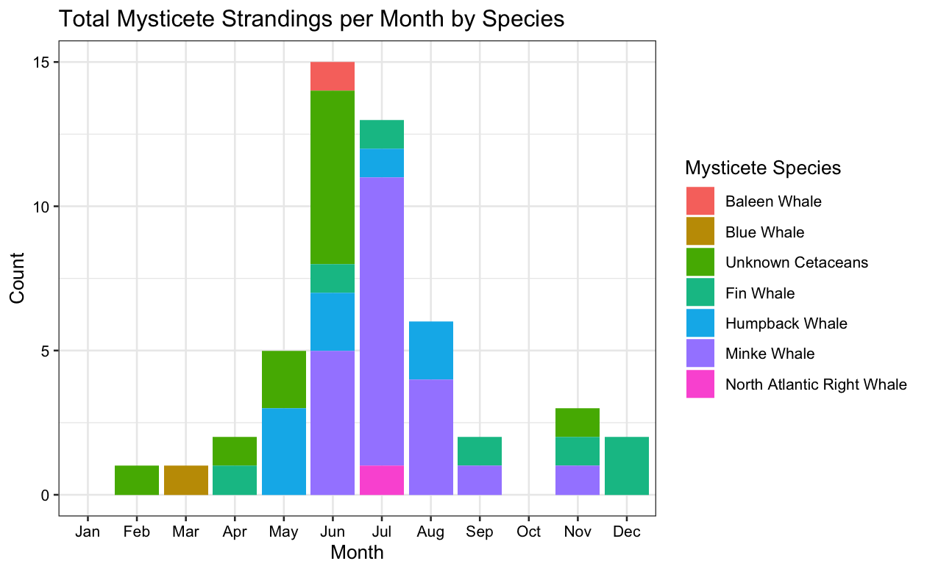
Mysticetes
No statistically significant year
May – June only statistically significant (p-values <0.05)

Slide 10
Geospatial analysis
Pinnipeds
425 of 679 strandings were within 40km of mean latitude and longitude
Sea Turtles
205 of 256 strandings were within 40km of mean latitude and longitude
Odontocetes
125 of 155 strandings were within 40km of mean latitude and longitude
Mysticetes
44 of 50 strandings were within 40km of mean latitude and longitude

Slide 11
Summary
Significance of year and month vary between family groups
Most strandings occurred within 40km of “mean” stranding point
Understanding how strandings change annually and monthly is necessary for stranding prevention and response, resource allocation, and conservation management
To improve this analysis, would be beneficial to have additional data on cause of stranding
***Time series results TBD***

